Slide 1
Fortran basic

Slide 2
Complier
Gfortran
Google search mingw-get-setup.exe
Download and installation
gfortran *.for *.f *.f90 -o test.exe
Set=Path c:\MinGW\bin;%path%
Set include=c:\MinGW\include
Set lib=c:\MinGW\lib

Slide 3
Complier
Batch File
set lib=c:\MinGW\lib
set include=c:\MinGW\include
path c:\MinGW\bin;%path%
CMD
For Linux g77 or gfortran
g77 *.for ➔ ./a.out
g77 *.for –o hello ➔ ./hello

Slide 4
Fortran is formatted
Fortran 77
Fixed Format
1-72 char
Program Test
declare
…..
Stop
End
Fortran 90
Free Format
1-132 char
Program test
declare
…
End program test

Slide 5
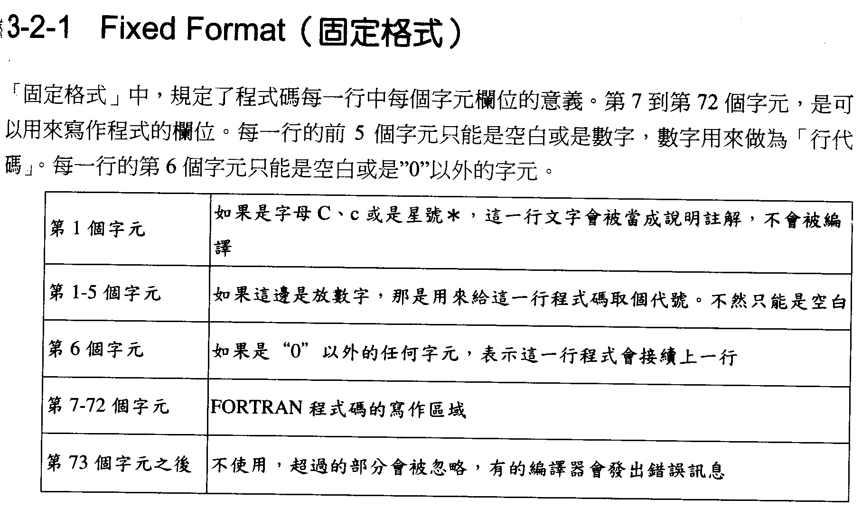
F77 Fixed Format
First Character ‘C’ or ‘c’ this line will be assumed as remark
1-5 Characters generally is number as level
6 character in not blank means connect to last line

Slide 6
Fixed Format (固定格式)
“Fixed Format” regulates different roles of character positions. Columns 7-72 are used for coding. The first 5 columns can only be blank or contain a numeric label. Column 6 can only be a nonblank, nonzero character to be identified as a continuation line.
Column(s) | Illustration
1 | If it is ‘C’, ‘c’, or ‘*’, this line will be treated as comment and not be compiled.
1-5 | If a number is put here, it is the lable of the line. Otherwise, it can only be blank.
6 | Except zero or blank, any character here indicates that this line is a continuation line.
7-72 | Coding region.
after 73 | Not using. Anything here will be omitted. Some compilers could report error message.
F77 Fixed Format
First Character ‘C’ or ‘c’ this line will be assumed as remark
1-5 Characters generally is number as level
6 character in not blank means connect to last line

Slide 7
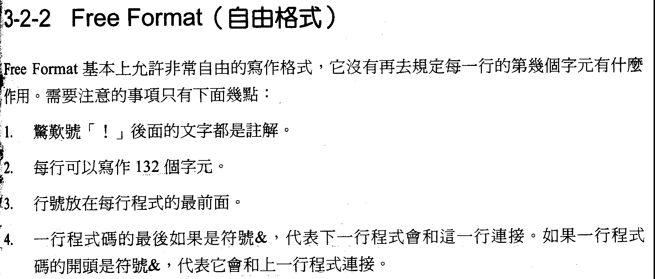
Fortran 90 is free format
First character ‘!’ later as remark will not be complied

Slide 8
Free Format (自由格式)
“Free Format” allows relatively free coding style. It doesn’t regulate the roles of each character position. Only need to be careful about the following points:
1. Anything after Exclamation Mark ‘!' is treated as comments.
2. At most 132 characters can be put in a line.
3. Line label should be at the beginning of a line.
4. If a line ends up with ‘&’, it indicates the next line continue from this line.
If a line starts with ‘&’, it continues from the previous line.
Fortran 90 is free format
First character ‘!’ later as remark will not be complied

Slide 9
常數與變數 Constant and Variable
不變為常數。 It cannot be changed value is constant
1,2,3,4.5….
parameter (n=100)
可改變的儲存數值的變數 Variable can store numerical value
A=10 ➔ print*,A
A=20 ➔ print*,A

Slide 10
變數的命名規則 Rule of the naming of variable
第一個字元不能為數字或特殊符號 First character cannot be number or particular sign
Yes: A1, B3,A_out …
No: 1A, 1B, *A, /A
變數中不能有運算符號 Character in the name of variable cannot be the sign of operator
No: A1/6, C&, C*Y …

Slide 11
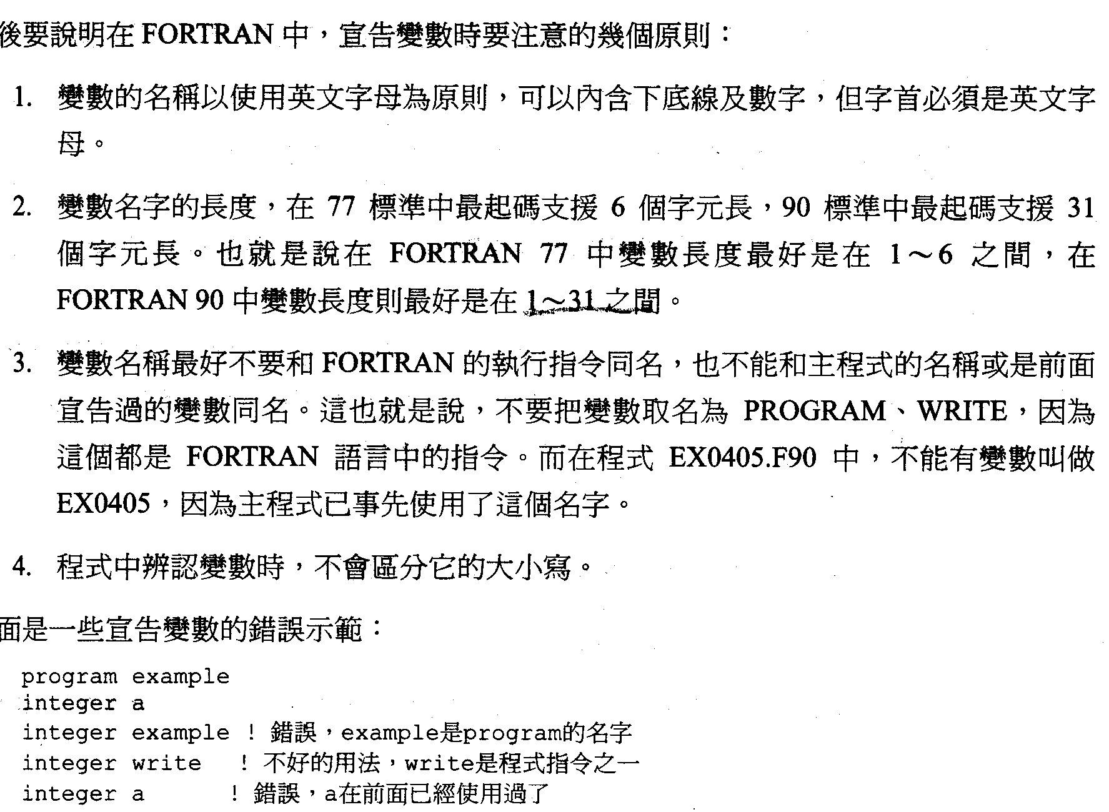

Slide 12
Rules for naming variable
Use English alphabet (A~Z, a~z). Can use ‘_’ or numbers (0~9), but the first character MUST BE an English letter.
The length of the variable should be between 1~6 in Fortran 77, and 1~31 in Fortran 90.
Don’t use keywords (https://fortranwiki.org/fortran/show/Keywords) because they are for other uses. Don’t use the same name as the main program or other variables which have been used. In EX0405.F90, ‘EX0405’ can’t be a variable because the main program is using it.
Names of variables are case insensitive.
Examples:
program example
integer a
integer example ! Wrong. ‘example’ has been used as the program’s name
integer write ! Not a good name. ‘write’ is a keyword
integer a ! Wrong. ‘a’ has been used above

Slide 13
Fortran’s Data Type

Slide 14
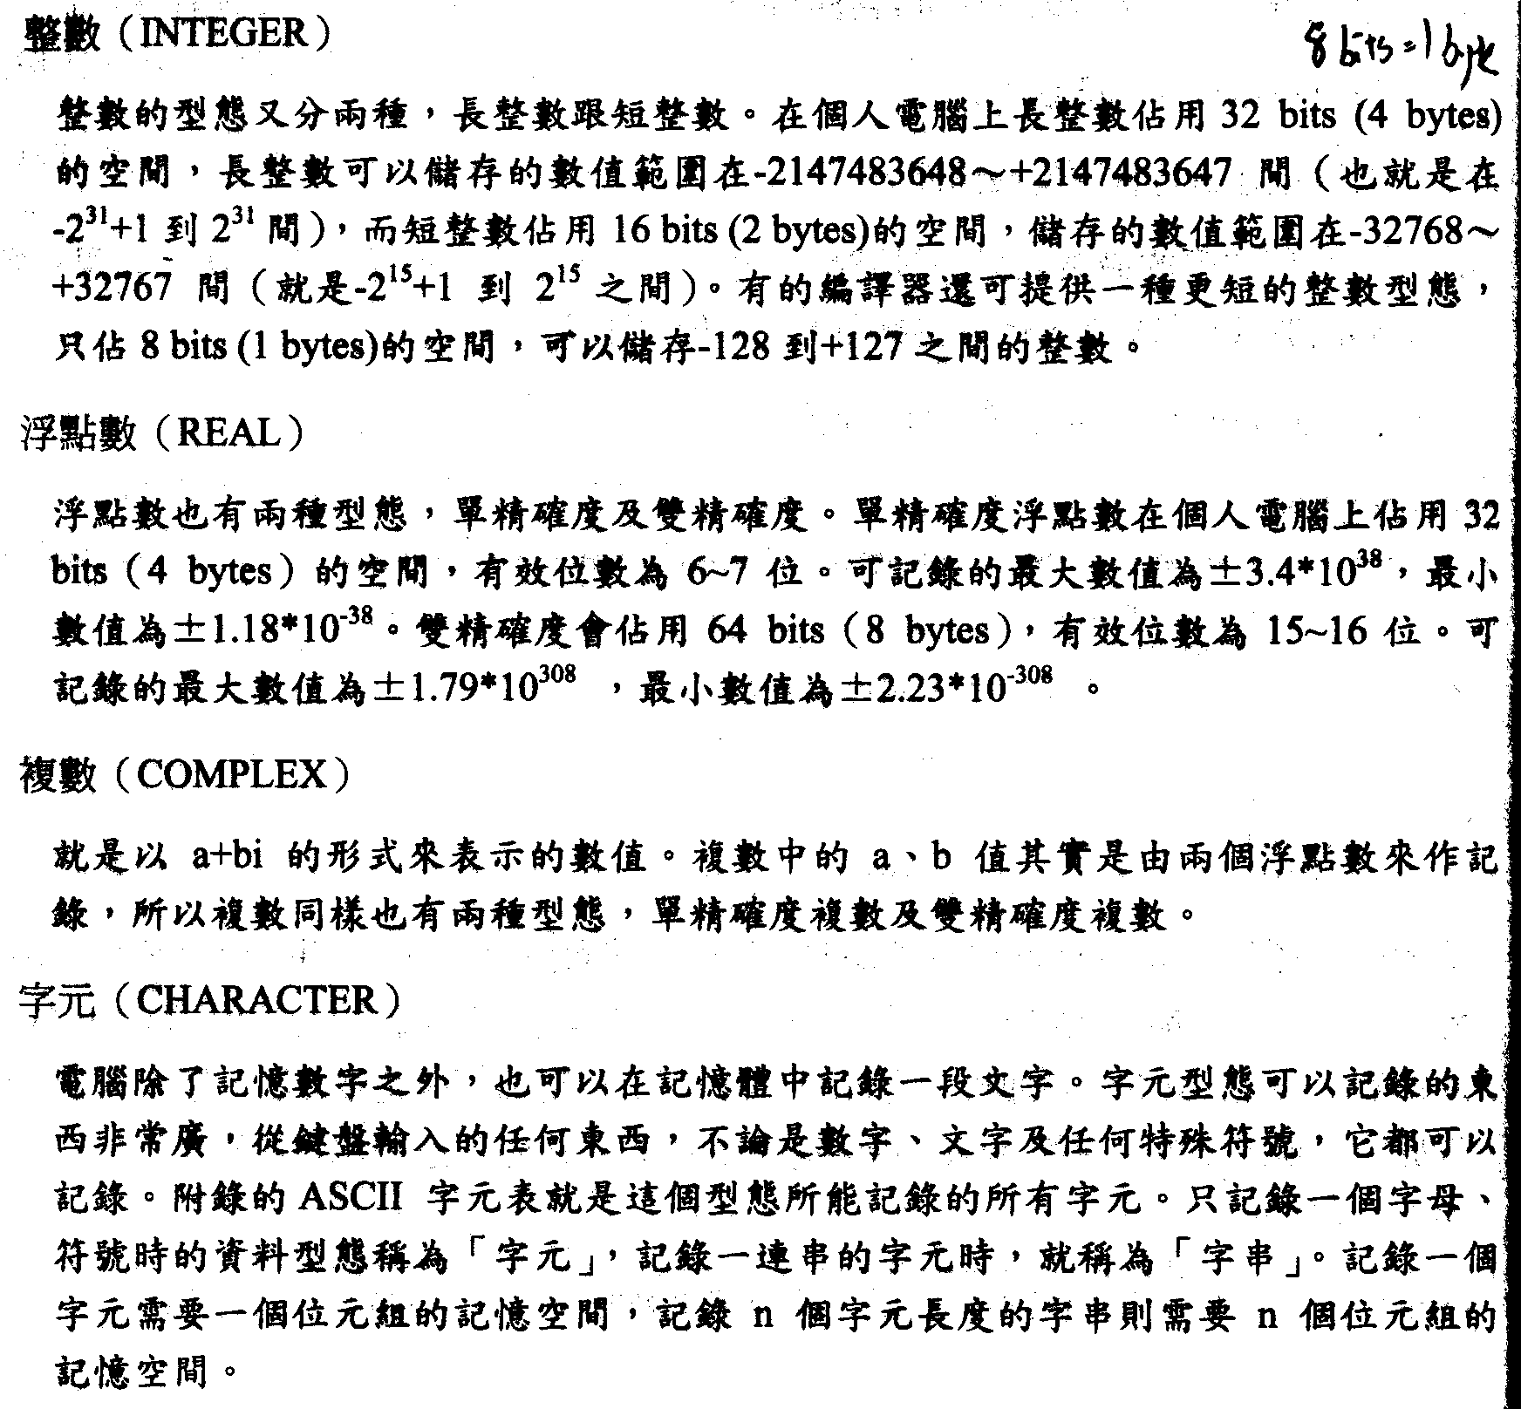
Integer
Three type 1 byte, 2 bytes and 4 bytes
1 byte ranges from -128 to 127
2 bytes ranges from -32768 to 32767
4 bytes ranges from -2**31 to 2**31-1

Slide 15
Real
Real has two type single precision (4 bytes, effective digits 6-7) and double precision (8 bytes, effective digits 15-16).
Truncations problem!

Slide 16
Float (Real)
Real has two type:
single precision:
4 bytes, effective digits 6-7
available maximum: ±3.4*10³⁸
available minimum: ±1.18*10⁻³⁸
double precision:
8 bytes, effective digits 15-16
available maximum: ±1.79*10³⁰⁸
available minimum: ±2.23*10⁻³⁰⁸
Truncations problem!

Slide 17
Complex a+bi
It has two type single precision and double precision

Slide 18
Character String
Character to store ASCII sign, 1 character as 1 byte (0-255)

Slide 19
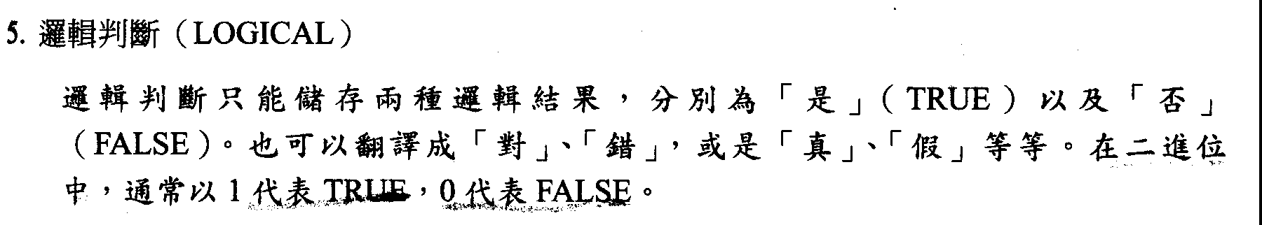
Logical
To store TRUE or FALSE. Generally, in binary 1 represents TRUE and 0 represents FALSE

Slide 20
Fortran 的運算符號 Sign of Fortran Operator
+ ➔ 加法 plus
- ➔ 減法 minus
* ➔ 乘法 multiple
/ ➔ 除法 divide
** ➔乘冪 power
() ➔刮號內優先計算 in Scratch deal first

Slide 21
簡單的輸出輸入 Simply input and output
Print*,A
Print*, ‘Output A value : ‘, A
Print*,A ➔ write(*,*)A
Keyboard input
Read(*,*)A

Slide 22
Example
! This is a test
Program Test
I=10
print*,’ I= ’,I
read(*,*)I
print*,’I changed to ‘,I
end

Slide 23
Declare
一般規則
字首(I-N)為整數，其餘為實數。
Generally rule in Fortran, the first character (I to N) as integer and others as real.

Slide 24
Integer
F77
Integer*4 a,b,c
Integer(2) a,b,c
Integer*1 a,b,c
Integer a(30),b(10,20)
F90 (added)
Integer(kind=2) :: A,B
Integer(kind=4) a,b,c

Slide 25
Real
F77
Real*8 a
Real*4 a
Real(8) a
Real a(30),b(20,4,100)
F90
Real(kind=8) :: a
Real(kind=4) a

Slide 26
Complex
F77
Complex*4 c
Complex*8 c
example
C=(A,B)
A+Bi
F90
Complex(kind=8) :: C
Complex(kind=4) C

Slide 27
Logical
Logical A
Logical*2 A
Logical(2) A
Logical(kind=4) :: A
A=.true.
A=.false.

Slide 28
Character And String
F77
Character A
A=‘B’
String
Character(10) A
Character*10 A
Character A*10
A=‘1234567890’
F90
Character :: A
String
Character(len=10) :: A
A=‘1234567890’

Slide 29
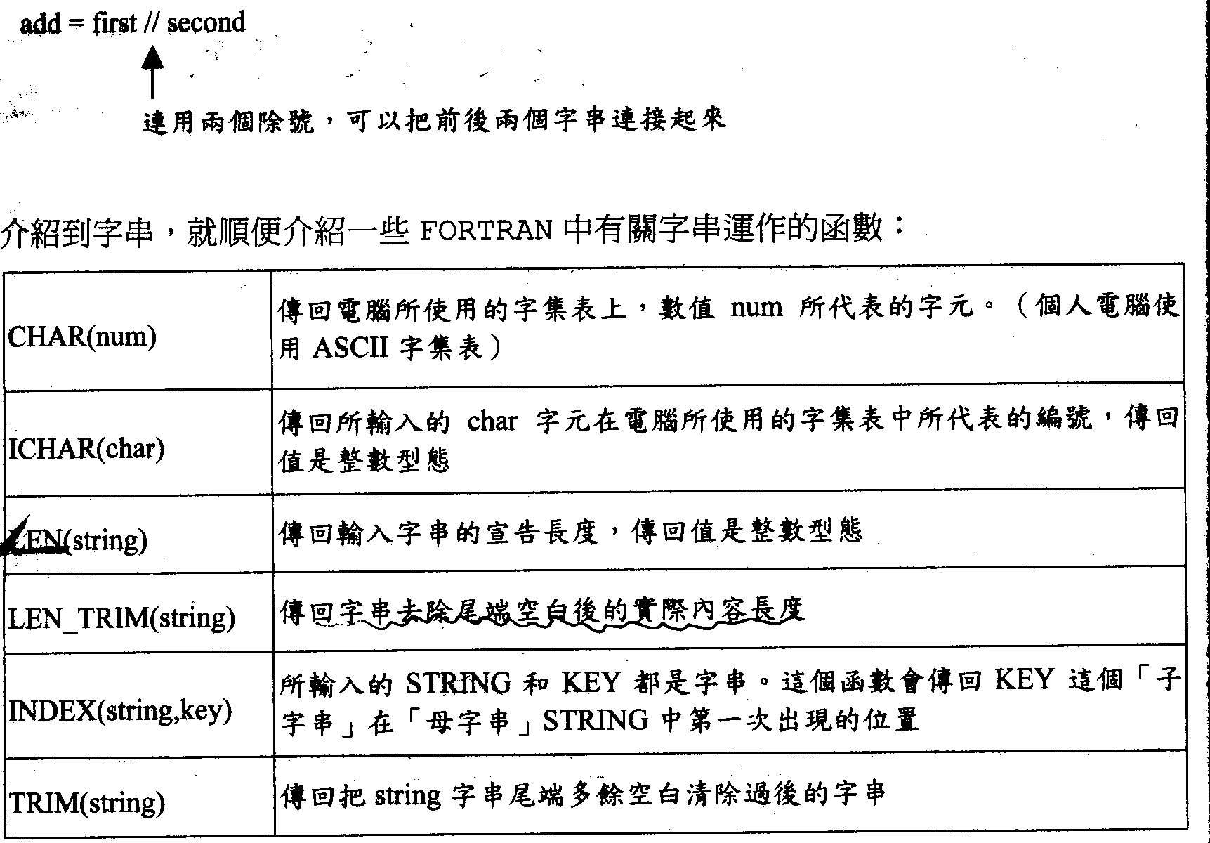

Slide 30
Some function for string
Char(I), I should be integer from 0-255, Char(I) returns ASCII sign of I.
Ichar(C), C is a character, Ichar(C) returns ASCII value (0-255) of C
INDEX(string, key), string and key are string, key is a sub-string and INDEX(string, key) returns key first appear position in string
Len_trim(S), S is a string. Len_trim(S) returns actually length of S

Slide 31
Some function for string
‘//’ can be used to connect two strings
(e.g. add = first // second)
Function | Illustration
Char(I) | I should be integer from 0-255, Char(I) returns ASCII sign of I.
Ichar(C) | C is a character, Ichar(C) returns ASCII value (0-255) of C.
Len(S) | S is a string. Len(S) returns length of S.
Len_trim(S) | S is a string. Len_trim(S) returns actually length of S.
INDEX(string, key) | string and key are string, key is a sub-string and INDEX(string, key) returns key first appear position in string.
TRIM(S) | S is a string. TRIM(S) returns S without any space at its end.

Slide 32
Homework-01
兩點決定一條直線，請寫一程式，輸入兩個點(x1,y1),(x2,y2)並決定這一條直線。
請寫一程式，輸入一個字串(includes “a” )，輸出字串的長度及字母a所在的位置。
請寫一程式，輸入一個小寫字母，輸出其大寫字母。

Slide 33
Homework 01
Two points decide a line. Please write a program that input two points (x1,y1), (x2,y2) to find the a, b of a line y=ax+b
To write code, it can input a string includes character ‘a’ and output the length of the input string as well as the first appear position of ‘a’
To write a code, it can input a lowercase string and output uppercase string.

